Slide 1

Java Features
Read README.md ;) as well
Azat Satklichov
azats@seznam.cz,
http://sahet.net/htm/java.html,
https://github.com/azatsatklichov/Java-Features
Notes:
JSLint can be found at http://www.JSLint.com/.
JavaScript statements are composed of: Values, Operators, Expressions, Keywords, and Comments.
JavaScript programs (and JavaScript statements) are often called JavaScript code.
var x, y, z; // Statement 1 x = 5; // Statement 2 y = 6; // Statement 3
var x = 5 * 10; //Statement 4
JavaScript uses the var keyword to declare variables.
An expression is a combination of values, variables, and operators, which computes to a value. E.g. 5 * 10 or x * 10
JavaScript variables are containers for storing data values.
All JavaScript variables must be identified with unique names. JavaScript identifiers are case-sensitive.
Creating a variable in JavaScript is called "declaring" a variable.
var carName;
Difference Between Unicode and UTF-8: Unicode is a character set. UTF-8 is encoding.
Unicode is a list of characters with unique decimal numbers (code points). A = 65, B = 66, C = 67, ....
This list of decimal numbers represent the string “ahello": 97 104 101 108 108 111
Encoding is how these numbers are translated into binary numbers to be stored in a computer:
UTF-8 encoding will store "hello" like this (binary): 01101000 01100101 01101100 01101100 01101111
Encoding translates numbers into binary . Character sets translates characters to numbers.

Slide 2
JAVA 9
List<String> ll = getList();
Stream<String> stream = ll == null ? Stream.empty(): ll.stream();
int count = Stream.ofNullable(ll).count(); System.out.println(count); //0
//or Apache CollectionUtils
org.apache.commons.collections4.CollectionUtils.emptyIfNull(list).stream()
//Java8 Optional.ofNullable
stream = Optional.ofNullable(ll).orElse(List.of()).stream();
Stream.of("a", "b", "c", " ", "d", "", "z").takeWhile(s -> !s.isEmpty()).forEach(System.out::print); //abc d
Stream.of("a", "b", "c", " ", "d", "", "z").dropWhile(s -> !s.isEmpty()).forEach(System.out::print);//z
Stream.of("a", "b", "c", " ", "d", "", "z").takeWhile(s -> !s.isBlank()).forEach(System.out::print);//abc
Stream.of("a", "b", "c", " ", "d", "", " ", "z").dropWhile(s -> !s.isBlank()).forEach(System.out::print);// d z
IntStream.iterate(0, x -> x < 100, i -> i + 4).forEach(System.out::print);
//04812162024
Stream API Improvements
//prevent NullPointerExceptions
Stream.ofNullable(), Stream.empty();
//more
takeWhile()[while true], dropWhile()[drops until true]
//more
.iterate() [hasNext predicate as parameter]
@Deprecated(forRemoval = true, since = "9")
e.g java.lang.Object#finalize, javax.net.ssl.HandshakeCompletedEvent#getPeerCertificateChain

Slide 3
Optional & other Improvements
List<Optional<String>> list = Arrays.asList(Optional.empty(), Optional.of("A"), Optional.empty(), Optional.of("B"));
List<String> filteredListJava9 = list.stream()
.flatMap(Optional::stream).collect(Collectors.toList()); //[A, B]
optional.ifPresentOrElse(x -> System.out.println("Value: " + x), () -> System.out.println("Not Present.")); //[A, B]
Optional<String> optional1 = Optional.of("Rimini"); Supplier<Optional<String>> supplierString = () -> Optional.of("Not Present"); optional1 = optional1.or(supplierString); optional1.ifPresent(x -> System.out.println("Value: " + x));//Value: Rimini
stream(), ifPresentOrElse(), or()
-- NEW Java9 Javadoc HTML5 way javadoc -d C:/JAVA_doc_new -html5 _IntroJava9.java
Jshell
Diagnostic tools: Jcmd, jinfo, jmap, jstat
https://visualvm.github.io
Multirelease:
> javac --release 7 JRelease7.java
javac --release 9 JRelease9.java

Slide 4
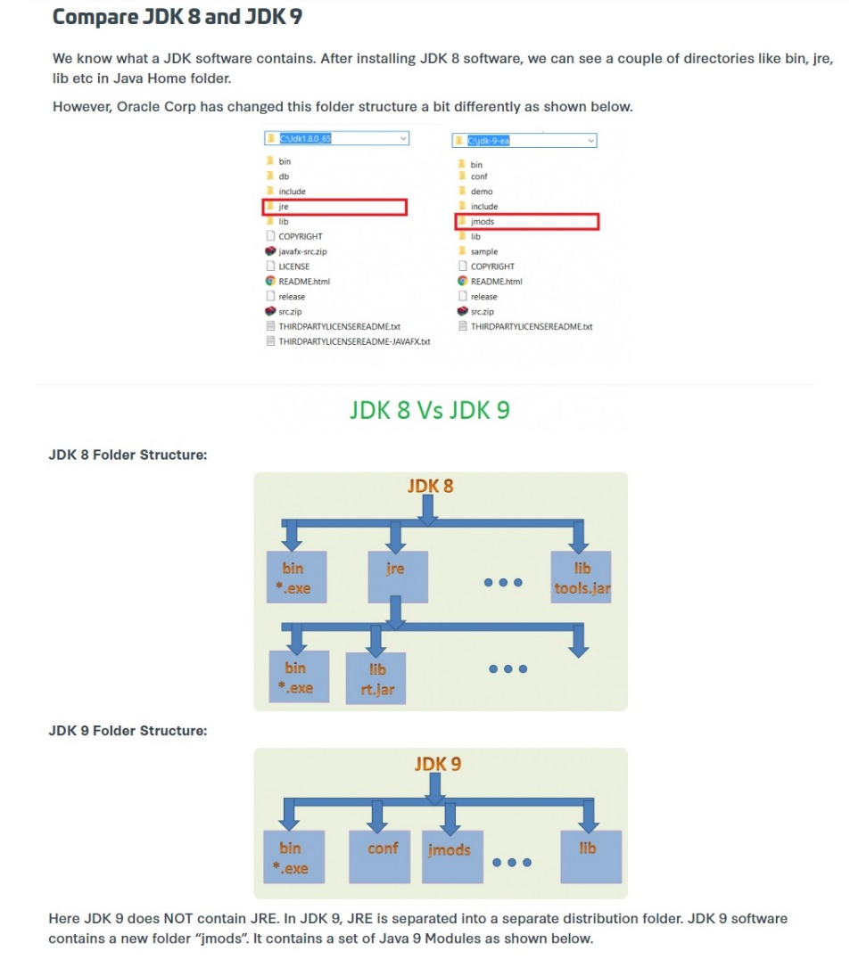
//Java 9//11 – modular, JEE removed
java --list-modules

Slide 5
JAVA 10 – Last free version of JDK
TRY: > cd cd C:\apps\Java\jdk-14\lib\security
> keytool -list -keystore cacerts * changeit
Root certificate - cacerts: With Java 10, Oracle has open-sourced the root certificates in Oracle
OptionalInt opInt = OptionalInt.of(12345); System.out.println("int Value via " + " orElseThrow() = " + opInt.orElseThrow());//NoSuchElementException
//existing one
IntStream.of(1, 2, 3).average(//).orElseThrow(() -> new IllegalArgumentException("Array is empty"));
//MAP.put(entry.getKey(), ImmutableSet.copyOf(entry.getValue()));
MAP.put(entry.getKey(), Set.copyOf(entry.getValue()));
List<Integer> evenList = ints.stream()
.filter(i -> i % 2 == 0).collect(Collectors.toUnmodifiableList());
evenList.add(4);// UnsupportedOperationException
Optional class improvement:
orElseThrow - java.util.Optional, java.util.OptionalDouble, java.util.OptionalInt and java.util.OptionalLong each got a new method orElseThrow()
Unmodifiable collections – copyOf() on List, Set, Map and
Collectors.toUnmodifiableList()

Slide 6
JAVA 11 – LTS Release after Java 8(2019), next is 17
Launch Single Source File without explicitly compiling
Run Shebang file
Java Flight Recorder (Events, Dataflows)
String methods
Files readString, writeString
New TLS crypto - ChaCha20, ..
Oracle JDK was licensed under Oracle Binary Code License Agreement. Stable and more performant.
OpenJDK has the GNU General Public License (GNU GPL) version 2 with a linking exception. OpenJDK, in contrast, will deliver releases more often.
There is no real technical difference between the two since the build process for the Oracle JDK is based on that of OpenJDK.
>java A_LaunchingSingleFileSourceFiles.java
For more about Java 1-15 Features:
https://github.com/azatsatklichov/Java-Features

Slide 7

THANK YOU

